Slide 1


M O N T E N E G R O
Negotiating Team for the Accession of Montenegro to the European Union
Working Group for Chapter 32 – Financial Control
Bilateral screening: Chapter 32
PRESENTATION OF MONTENEGRO
Brussels, 19th June 2013

Slide 2


Financial Control
Chapter 32:
EXTERNAL AUDIT:
STATE OF PLAY AND FUTURE STEPS
Stana Bešović
State Audit Institution
stana.besovic@dri.co.me
M O N T E N E G R O
Negotiating Team for the Accession of Montenegro to the European Union
Chapter 32:
Financial Control

Slide 3
Financial Control
Chapter 32:
INTRODUCTION
State audit institution established under Law on State audit institution (April 2004);
State audit institution legally positioned within the Constitution of Montenegro (October 2007);
Compliance of national legislature and working methods with Lima Declaration, Mexico Declaration, ISSAI auditing standards, European Implementing guidelines for the INTOSAI Auditing Standards is of great importance for external government auditing;
M O N T E N E G R O
Negotiating Team for the Accession of Montenegro to the European Union
Chapter 32:
Financial Control

Slide 4
Chapter 32 : Financial Control
PRESENTATION STRUCTURE
1. Constitutional position of SAI
Legal framework
Strategic development plan for 2012 - 2017
Implementation of ISSAI auditing standards
International cooperation and trainings
Statistical data
M O N T E N E G R O
Negotiating Team for the Accession of Montenegro to the European Union
Chapter 32:
Financial control

Slide 5
Chapter 32 : Financial Control
1. Constitutional position of SAI
In accordance with Lima Declaration, State audit institution was legally positioned in the Constitution of Montenegro in October 2007 (Article 144.);
“The National Audit Institution of Montenegro shall be an independent and supreme authority of the national audit. The National Audit Institution shall audit the legality of and success in the management of state assets and liabilities, budgets and all the financial affairs of the entities whose sources of finance are public or created through the use of state property.
The National Audit Institution shall submit an annual report to the Parliament.
The Senate shall manage the National Audit Institution.”
M O N T E N E G R O
Negotiating Team for the Accession of Montenegro to the European Union
Chapter 32:
Financial control

Slide 6
Chapter 32: Financial Control
1. Constitutional position of SAI
State audit institution initiated the amendment to the Constitution of Montenegro for ensuring functional immunity of President and members of Senate;
The amendment is included in the Draft amendments to the Constitution of Montenegro;
M O N T E N E G R O
Negotiating Team for the Accession of Montenegro to the European Union
Chapter 32:
Financial Control

Slide 7
Chapter 32: Financial Control
2. Legal framework of SAI
Legal framework of SAI is prescribed in the Law on SAI, April 2004;
The Law on SAI was drafted taking into account its compliance with Lima Declaration, ISSAI auditing standards (basic principles, general standards, field standards, reporting standards).
The Law on SAI includes following provisions:
Independence of Institution;
Audited entities, tasks of Institution, types of audits;
Scope, time and method of performing audits;
Organization of Institution (independence of members of Senate, appointment and dismissal of members of Senate as well as supremacies of the institutional bodies);
Cooperation with Parliament and Government;
Informing public;
Relation with audit entities;
Responsibility of state auditors (qualifications, competencies and legal requirements for appointment of state auditors);
Financing Institution.
M O N T E N E G R O
Negotiating Team for the Accession of Montenegro to the European Union
Chapter 32:
Financial Control

Slide 8
Chapter 32: Financial Control
2. Legal framework of SAI
In accordance with the Law on SAI, the Institution adopted following sub-legal acts:
Rules of procedure of the State audit institution (“Official Gazette of RMN”, No. 50/07);
Instruction on the methodology of work of the State audit institution (“Official Gazette of RMN”, No. 50/07);
Code of ethics of the state officers and employees in the State audit institution;
Rule book on internal organization and systematization of posts within the State audit institution.
M O N T E N E G R O
Negotiating Team for the Accession of Montenegro to the European Union
Chapter 32:
Financial Control

Slide 9
Chapter 32: Financial Control
2. Legal framework of SAI
Independence of Supreme audit institution is one of the most important elements of Lima and Mexico Declaration, as well as ISSAI standards. The concept of independence of SAIs includes: functional, organizational, managerial and financial independence.
Functional independence – prescribed in the Article 2 and 9 of the Law on SAI.
M O N T E N E G R O
Negotiating Team for the Accession of Montenegro to the European Union
Chapter 32:
Financial Control

Slide 10
Chapter 32: Financial Control
2. Legal framework of SAI
Organizational independence – defined in the Article 29 and 30 of the Law on SAI;
Managerial independence – defined in the Article 33 and 34 of the Law on SAI;
Independence of state auditors – defined in the Article 10 and 45 of the Law on SAI;
M O N T E N E G R O
Negotiating Team for the Accession of Montenegro to the European Union
Chapter 32:
Financial Control

Slide 11
Chapter 32: Financial Control
2. Legal framework of SAI
Financial independence
Financing of the Institution is prescribed in Article 51 of the Law on SAI
  „The funds for the activities of the Institution shall be provided in the budget of Montenegro.
  The request for allocation of budget funds to the Institution shall be submitted by the Parliamentary Committee in charge of financial activities, upon request of the Institution.“
State audit institution aims to ensure full financial independence.
M O N T E N E G R O
Negotiating Team for the Accession of Montenegro to the European Union
Chapter 32:
Financial Control

Slide 12
Chapter 32: Financial Control
2. Legal framework of SAI
Mandate of SAI – defined in the Article 4 of the Law on SAI;
Audit tasks - defined in the Article 5 of the Law on SAI;
Law on amendments to the Law on financing political parties, January 2012 – State audit institution performs audit of annual financial statements of political parties and audit on report on the origin, amount and structure of the funds raised and spent on election campaign;
M O N T E N E G R O
Negotiating Team for the Accession of Montenegro to the European Union
Chapter 32:
Financial Control

Slide 13
Chapter 32: Financial Control
2. Legal framework of SAI
Relation with audit entities – defined in the Article 10 of the Law on SAI;
Cooperation with Parliament and Government – defined in the Article 18 of the Law on SAI;
Scope, time and method of performing audits – defined in the Article 9 of the Law on SAI;
Informing public – defined in the Article 50 of the Law on SAI;
M O N T E N E G R O
Negotiating Team for the Accession of Montenegro to the European Union
Chapter 32:
Financial Control

Slide 14

Chapter 32: Financial Control
2. 1. Proposal of amendments to the Law on SAI
Proposal of amendment to the Article 51 of the Law
on SAI with aim to strengthen financial
independence:
“The Institution shall be financed from the State Budget for fiscal year.
The Parliamentary Working body in charge of budget, upon request of the Senate, establishes the draft budget of the State audit institution.
The budget proposal from paragraph 2 under this Article is constituent part of the Proposal of the Law on annual state budget.”
M O N T E N E G R O
Negotiating Team for the Accession of Montenegro to the European Union
Chapter 32:
Financial Control

Slide 15
Chapter 32: Financial Control
2. 1. Proposal of amendments to the Law on SAI
Amendments to the Law on SAI includes:
Exclusion of obligation to apply regulations which prescribe positions and rights of state officials and employees, so that it strengthen the independence and managerial function of the Institution, as well as that salaries, fees and other personal incomes of the employees are regulated by a separate Law;
“The Institution shall audit the legality of and success in the management of state assets and liabilities, budgets and all the financial affairs of the entities whose sources of finance are public or created through the use of state property. The Institution performs audits in a manner and procedure in accordance with the Framework of International Standards for Supreme Audit Institutions and the Code of Ethics for auditors”;
Obligation of audit entity to submit its report on realization of recommendations related to audit report within the time frame set by the Institution.
M O N T E N E G R O
Negotiating Team for the Accession of Montenegro to the European Union
Chapter 32:
Financial Control

Slide 16
Chapter 32: Financial Control
3. Strategic Development Plan for 2012-2017
The basis for defining development goals in the Strategic Development
Plan:
Self-assessment Report, prepared by the employees of the Institution;
Peer review Report, prepared by the SIGMA expert team;
Strategic Development Plan for 2012 - 2017 – adopted in April 2012;
Strategic Development Plan of the SAI for 2012-2017 includes following strategic goals:
improvement of the legal framework of the state audit
institution;
2. introduction of new types of audits, audit quality improvement
and ensuring quality control of audits;
3. capacity building of the institution;
4. improvement of the information system of the institution;
5. improvement of communication policies
M O N T E N E G R O
Negotiating Team for the Accession of Montenegro to the European Union
Chapter 32:
Financial Control

Slide 17
Chapter 32: Financial Control
3.1. Action development plan of SAI for 2012-2017
Action Plan for 2012-2017 – adopted in June 2012;
In accordance with Strategic Development Plan of the Institution, Action plan includes following elements:
Strategic goals;
Sub-goals;
Planned activities;
Timeline;
Implementation steps;
Individual responsible for performing activities;
Expected results;
Evaluations results;
Monitoring activities;
Timetable framework for monitoring;
Evidence for monitoring conducted;
Necessary financial resources.
M O N T E N E G R O
Negotiating Team for the Accession of Montenegro to the European Union
Chapter 32:
Financial Control

Slide 18
Chapter 32: Financial Control
4. Implementation of ISSAI auditing standards
State audit institution – member of INTOSAI (2007) and EUROSAI (2008);
State audit institution – member of „Network of Supreme audit institutions of candidate countries and potential countries of EU“;
Decision of adopting translation of ISSAI auditing standards (Lima Declaration, Mexico Declaration, basic principles in government auditing, general standards in government, field standards and reporting standards) – adopted in 2005;
Amendments to the Law on SAI define obligation of the SAI to comply with ISSAI auditing standards;
M O N T E N E G R O
Negotiating Team for the Accession of Montenegro to the European Union
Chapter 32:
Financial Control

Slide 19
Chapter 32: Financial Control
4. Implementation of ISSAI auditing standards
Planned activities with aim to harmonize auditing practice with the ISSAI standards are included within Strategic Goal No.2 –
“Introduce new types of audits, improve the quality of audits and ensure quality control of audits in accordance with the ISSAI framework of the auditing standards, and ensure an efficient system for monitoring the implementation of recommendations of the State Audit Institution”;
Strategic goal 2, sub-goal 1–
„Introduce new types of audits in accordance with the ISSAI framework of the auditing standards and EU practice: performance audit and special types of audits (audits of the financing of political parties, environmental audits, audits of EU funds and IT systems audit);
INTOSAI Code of Ethics for auditors in public sector – adopted in 2006;
M O N T E N E G R O
Negotiating Team for the Accession of Montenegro to the European Union
Chapter 32:
Financial Control

Slide 20
Chapter 32: Financial Control
4.1. Auditing process
„Manual on planning and performing financial audit and regularity audit“ and “Manual on accounting and auditing of enterprises of public sector”– adopted in 2012 aligned with ISSAI standards and European Implementing guidelines for the INTOSAI Auditing Standards;
Manual on planning and performing financial audit and regularity audit deals with all important aspects and issues which are important in the audit cycle in the area of financial and regularity audit;
Manual on accounting and auditing of enterprises in public sector represents a set of accounting technics, standards and auditing procedures in the area of real sector;
SAI plans to draft the Performance Audit Manual aligned with ISSAI 300, 3000 and 3100;
M O N T E N E G R O
Negotiating Team for the Accession of Montenegro to the European Union
Chapter 32:
Financial Control

Slide 21
Chapter 32: Financial Control
4.1. Auditing process
„Manual on planning and performing financial audit and regularity audit“ includes following chapters:
Annual audit plan;
Audit entity analysis;
Determining risk indicators, materiality and sample;
Preparation of detailed audit plan;
Conduct of auditors in collecting data available within audit entities;
Gathering and evaluating evidence by auditors;
Development of audit minutes and audit reports;
Mandatory contents of financial audit report (financial audit);
Giving an opinion in line with the ISSAI standards;
Materially significant non-compliance;
Audit follow up procedures;
Audit documentation, record keeping and confidential data protection
The Manual also includes internal control tests according to expenditures lines and audit program.
M O N T E N E G R O
Negotiating Team for the Accession of Montenegro to the European Union
Chapter 32:
Financial Control

Slide 22
Chapter 32: Financial Control
4.1. Auditing process
The Manual includes a comprehensive audit process:
Annual audit plan – defined in the Article 9 and 38 of the Law on SAI;
The criteria for including other entities in the annual audit plan are:
• Information from other state authorities, local self-government units and other
state-owned or local self-government owned entities, natural or legal persons;
• Information from other sources, such as print and other media;
• Information available to auditors;
• Opinions expressed in previous audit
M O N T E N E G R O
Negotiating Team for the Accession of Montenegro to the European Union
Chapter 32:
Financial Control

Slide 23
Chapter 32: Financial Control
4.1. Auditing process
Determining risk indicators, materiality and sample -
professional approach to determining risk indicators, materiality and sample in accordance with international standards; approach of quality in audit planning and more efficient conduct of audits.
Audit follow up procedures – Amendments to the Law on SAI prescribe obligation of audit entity to submit its report on realization of recommendations related to audit report within the time frame set by the Institution;
M O N T E N E G R O
Negotiating Team for the Accession of Montenegro to the European Union
Chapter 32:
Financial Control

Slide 24
Chapter 32: Financial Control
5. International cooperation and trainings
State audit institution realizes good international cooperation with:
INTOSAI and EUROSAI Supreme audit institutions;
European Court of Auditors;
Network of SAI of candidate countries and potential candidates countries of EU.
Cooperation with international organization – SIGMA and UNDP;
Application for twinning light project „Audit Quality Control within the SAI“;
Bilateral cooperation with Supreme audit institution from the region;
M O N T E N E G R O
Negotiating Team for the Accession of Montenegro to the European Union
Chapter 32:
Financial Control

Slide 25
Chapter 32: Financial Control
5. International cooperation and trainings
Ten-year cooperation with GIZ - Project „Creation and Establishment of Supreme audit institution in Montenegro“ and „Strengthening of external audit in Montenegro“;
Institutional cooperation with the National Audit Office of Sweden in area of development performance audit – 2012;
With aim to enhance professional skills and knowledge of audit staff, State audit institution conducted trainings internally and with the support of external experts;
M O N T E N E G R O
Negotiating Team for the Accession of Montenegro to the European Union
Chapter 32:
Financial Control

Slide 26
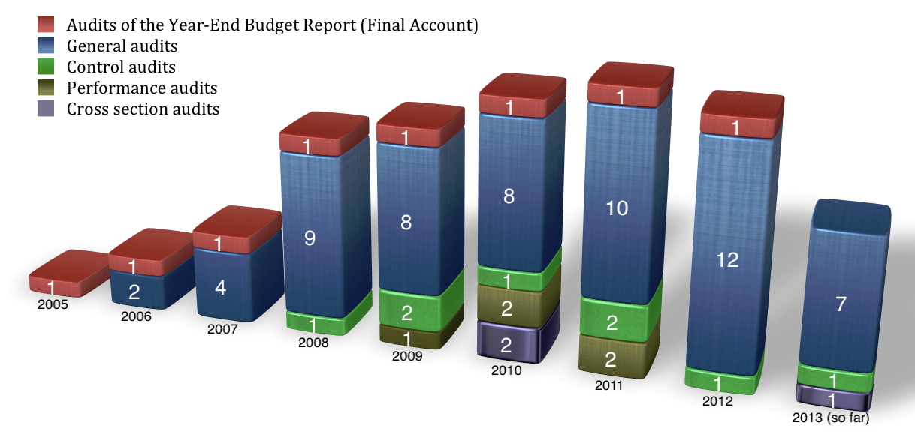
Chapter 32: Financial Control
6. Statistical data
M O N T E N E G R O
Negotiating Team for the Accession of Montenegro to the European Union
Chapter 32:
Financial Control

Slide 27
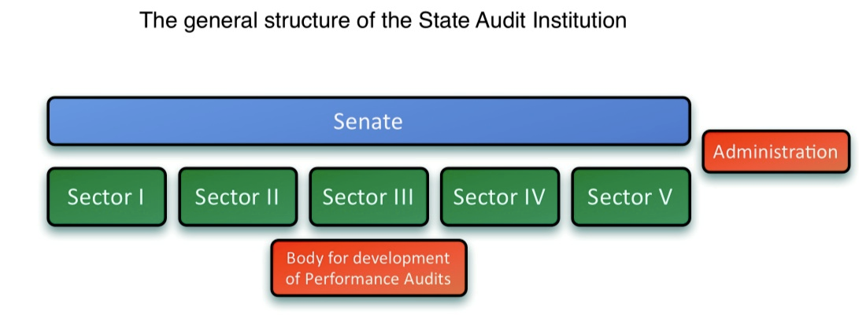
Chapter 32: Financial Control
6. Statistical data
M O N T E N E G R O
Negotiating Team for the Accession of Montenegro to the European Union
Chapter 32:
Financial Control

Slide 28
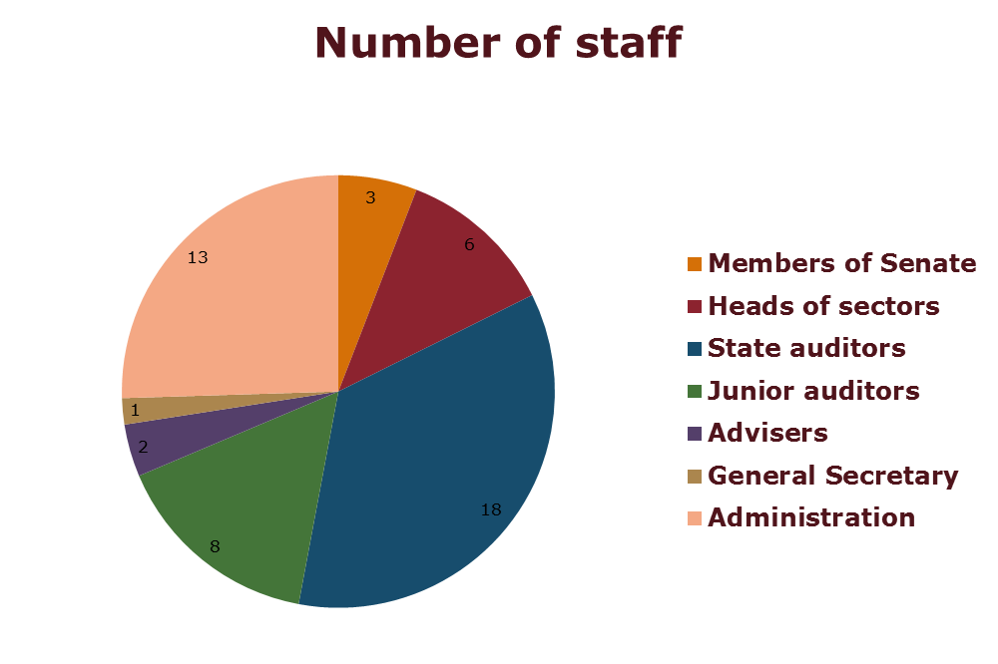
Chapter 32: Financial Control
6. Statistical data
M O N T E N E G R O
Negotiating Team for the Accession of Montenegro to the European Union
Chapter 32:
Financial Control

Slide 29
Chapter 32: Financial Control
FUTURE STEPS:
Further development of the SAI will refer to realization of following activities:
1. Amendments to legal framework;
2. Harmonization of working method with ISSAI auditing standards.
M O N T E N E G R O
Negotiating Team for the Accession of Montenegro to the European Union
Chapter 32:
Financial Control

Slide 30
Thank you for your attention!
QUESTIONS

