Slide 1


M O N T E N E G R O
Negotiating Team for the Accession of Montenegro to the European Union
Working Group for Chapter 28 – Consumer and Health Protection
Bilateral screening: Chapter 28
PRESENTATION OF MONTENEGRO
Brussels, 15-16 April 2013

Slide 2
Chapter 28: Consumer and Health Protection
eHealth
Natasa Terzic
Director of the Center for Health System Development
Institute of Public Health
natasa.terzic@ijzcg.me
M O N T E N E G R O
Negotiating Team for the Accession of Montenegro to the European Union
Chapter 28: CONSUMER AND HEALTH PROTECTION

Slide 3
Relevant Acquis
Chapter 28: Consumer and Health Protection
Directive of the European Parliament and of the Council on the application of patients’ rights in cross-border healthcare (2011/24/EU)
Commission Implementing Decision providing the rules for the establishment, the management and the functioning of the network of national responsible authorities on eHealth (2011/890/EU)
Communication from the Commission COM(2012) 736 final: eHealth Action Plan 2012-2020 – Innovative healthcare for the 21st century
M O N T E N E G R O
Negotiating Team for the Accession of Montenegro to the European Union
Chapter 28: CONSUMER AND HEALTH PROTECTION

Slide 4
Contents
Chapter 28: Consumer and Health Protection
Relevant IT document
Basic concepts of Integral Health Information System (HIS)
HIS development chronology
IT system modules and functionalities
E-services
Electronic Health Record
Common resources
Vision - Further HIS development
M O N T E N E G R O
Negotiating Team for the Accession of Montenegro to the European Union
Chapter 28: CONSUMER AND HEALTH PROTECTION

Slide 5
Relevant IT document
Chapter 28: Consumer and Health Protection
Strategy for development of information society 2012-2016, Ministry of information society and telecommunication, dec. 2011
M O N T E N E G R O
Negotiating Team for the Accession of Montenegro to the European Union
Chapter 28: CONSUMER AND HEALTH PROTECTION

Slide 6
Basic concepts of Integral HIS
Chapter 28: Consumer and Health Protection
HIS development on unique/integral basis
Setting up of unique parameters and coding system for
data recording and communication – legal framework
Centralized maintenance of common databases and
standard classifications
Electronic Health Record
Interconnected system modules
Open and upgradable system
M O N T E N E G R O
Negotiating Team for the Accession of Montenegro to the European Union
Chapter 28: CONSUMER AND HEALTH PROTECTION

Slide 7
HIS Development -chronology
Chapter 28: Consumer and Health Protection
2012 – IS Agency for drugs and med. devices
2012 – Health Statistics Information System
2010 - IS Emergency Medical Care
2010 – IS General Hospitals
2009 – IS Primary Health Care (completed)
2008 – IS Dental Offices (contracts with HIF)
2007- Pilot IS Primary Health Care (3 PHC Centers)
2006 – IS of HIF (on-line)
M O N T E N E G R O
Negotiating Team for the Accession of Montenegro to the European Union
Chapter 28: CONSUMER AND HEALTH PROTECTION

Slide 8
Integrated HIS Modules and Functionalities
Chapter 28: Consumer and Health Protection
Primary Health Care
Bussines Information System Medical Information System
- Human resources manag. - Choosen Doctor – Application
- Finance Management CONTACT, scheduling , EHR
- Inventory management - Support Centers of PHC (diagnostics, mental health, pulmonary dis.)
-Support units (patronage, physical med.)
- Invoicing services -Specialist services, etc.
M O N T E N E G R O
Negotiating Team for the Accession of Montenegro to the European Union
Chapter 28: CONSUMER AND HEALTH PROTECTION

Slide 9
HIS Modules and Functionalities
Chapter 28: Consumer and Health Protection
Secondary health care – General Hospitals (integrated module)
Bussines Information System Medical Information System
- Human resources manag. - Specialist service – Application “Visit”
- Finance Management (doctor and nurse)
- Inventory management - Stationary health care - Pharmacy management - patient admission and discharge
- ward doctor
- Invoicing services - ward nurse
- Operating theatre
M O N T E N E G R O
Negotiating Team for the Accession of Montenegro to the European Union
Chapter 28: CONSUMER AND HEALTH PROTECTION

Slide 10
Health Statistics Information System
(integrated HIS module)
Chapter 28: Consumer and Health Protection
Institute of Public Health - 2012
Health Statistics Management Reporting System
- outpatient databases - PHC regular reports
- inpatient databases - GH regular reports
- diseases registries (communicable dis., - “ad hoc” reporting
cancer, diabetes, acute coronary syndrome, cvd)
- system registries (human resources, health
care providers)
M O N T E N E G R O
Negotiating Team for the Accession of Montenegro to the European Union
Chapter 28: CONSUMER AND HEALTH PROTECTION

Slide 11
Data flows and e-services (internal interoperability)
Chapter 28: Consumer and Health Protection
Primary health care providers
Pharmacy Institution
electronic prescription
realization report
e-infectious disease notification
electronic invoicing
electronic specialist report
electronic discharge letter
electronic adverse effects of drugs
electronic refer
Agency for drugs
and med. devices
Health Insurance Fund
General Hospitals
electronic invoicing
IPH
e-infectious disease notification
M O N T E N E G R O
Negotiating Team for the Accession of Montenegro to the European Union
Chapter 28: CONSUMER AND HEALTH PROTECTION

Slide 12

Electronic health record
Chapter 28: Consumer and Health Protection
Application CONTACT in PHC EHR
Administr. patient data Patient general data
Personal anamnesis Anamnesis
Risk factors and allergies Episodes of treatments
episodes of treatment Therapies
Interventions and procedures
Diagnoses (ICPC-2/ICD-10) Immunisation record
Health services Risk factors
Allergies
Referrals inside PHC Hospital treatments
Referrals outside PHC Available at point of care: Specialist reports
Ordering of interv. and procedures PHC doctor
Prescription specialist in outpatient service
Sick leave (medical report) ward doctor
Reporting to ISIPH, ISADMD
M O N T E N E G R O
Negotiating Team for the Accession of Montenegro to the European Union
Chapter 28: CONSUMER AND HEALTH PROTECTION

Slide 13
Common Resources
Chapter 28: Consumer and Health Protection
DATABASES STANDARDS
(Intern. Classifications)
Database of insurees ICD-10
Database of phycisians, pharm.,dentists ICPC-2
Database of health care providers ATC/DDD
Database of medicines (positive list)
System Parameters
M O N T E N E G R O
Negotiating Team for the Accession of Montenegro to the European Union
Chapter 28: CONSUMER AND HEALTH PROTECTION

Slide 14
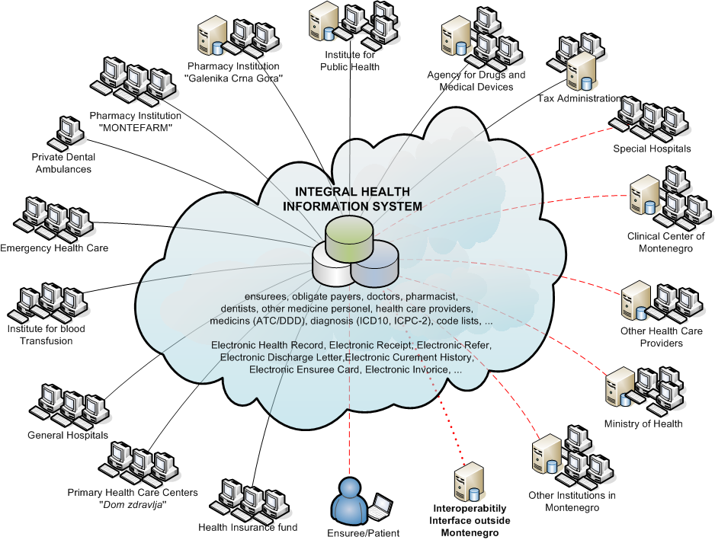
Future Vision
Chapter 28: Consumer and Health Protection
M O N T E N E G R O
Negotiating Team for the Accession of Montenegro to the European Union
Chapter 28: CONSUMER AND HEALTH PROTECTION

Slide 15
Thank you for your attention.
QUESTIONS

