Slide 1

M O N T E N E G R O
Negotiating Team for the Accession of Montenegro to the European Union
Working Group for Chapter 29 – Customs union
Bilateral screening: Chapter 29
PRESENTATION OF MONTENEGRO
Customs Administration of Montenegro
Introduction
Brussels, June 2013

Slide 2
Cultural property and precursors
Customs procedures
CUSTOMS UNION
Chapter 29:
Customs Law
Customs Service Law
Implementing provisions to the Customs Law
Decision on control list for export, import and transit of goods
Rulebook on form, method of submission and filling of customs declaration and summary declaration
M O N T E N E G R O
Negotiating Team for the Accession of Montenegro to the European Union
Chapter 29:
Customs union

Slide 3
CUSTOMS UNION
Chapter 29:
Cultural property
Works of art, collectors’ pieces and antiques (Chapter 97)
Export – permit (D4) from the Ministry of Culture
M O N T E N E G R O
Negotiating Team for the Accession of Montenegro to the European Union
Chapter 29:
Customs union

Slide 4
Precursors
CUSTOMS UNION
Chapter 29:
•Law on Control of Production and Release into Circulation of Substances that can be used in Manufacturing Narcotics and Psychotropic Substances (Official Gazette of Montenegro 83/2009)
•List of precursors (annex 3)
•Import, export and transit – permit (D4) from the Ministry of Health, i.e. Agency for Medicines and Medical Devices
•Lodging of permit to the customs authority (Article 24)
•Protocol on cooperation with the Agency for Medicines and Medical Devices
•Seminars and trainings (OSCE Control of precursors in manufacturing of narcotic drugs)
M O N T E N E G R O
Negotiating Team for the Accession of Montenegro to the European Union
Chapter 29:
Customs union

Slide 5
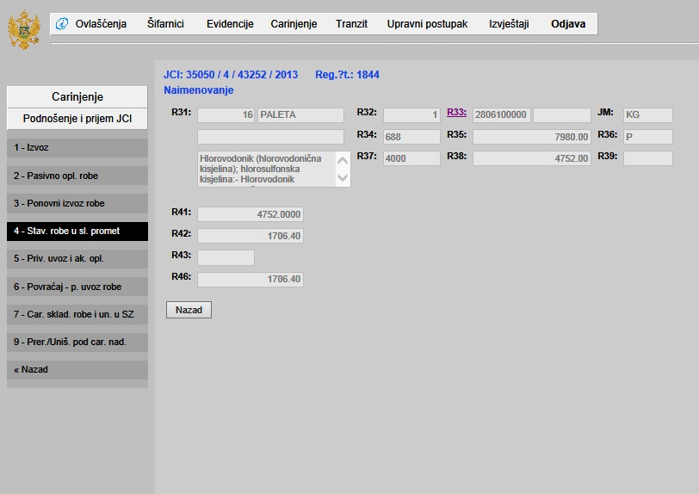
TARIC
CUSTOMS UNION
Chapter 29:
Chapter 29:
Customs union
M O N T E N E G R O
Negotiating Team for the Accession of Montenegro to the European Union
Chapter 29:
Customs union
M O N T E N E G R O
Negotiating Team for the Accession of Montenegro to the European Union

Slide 6
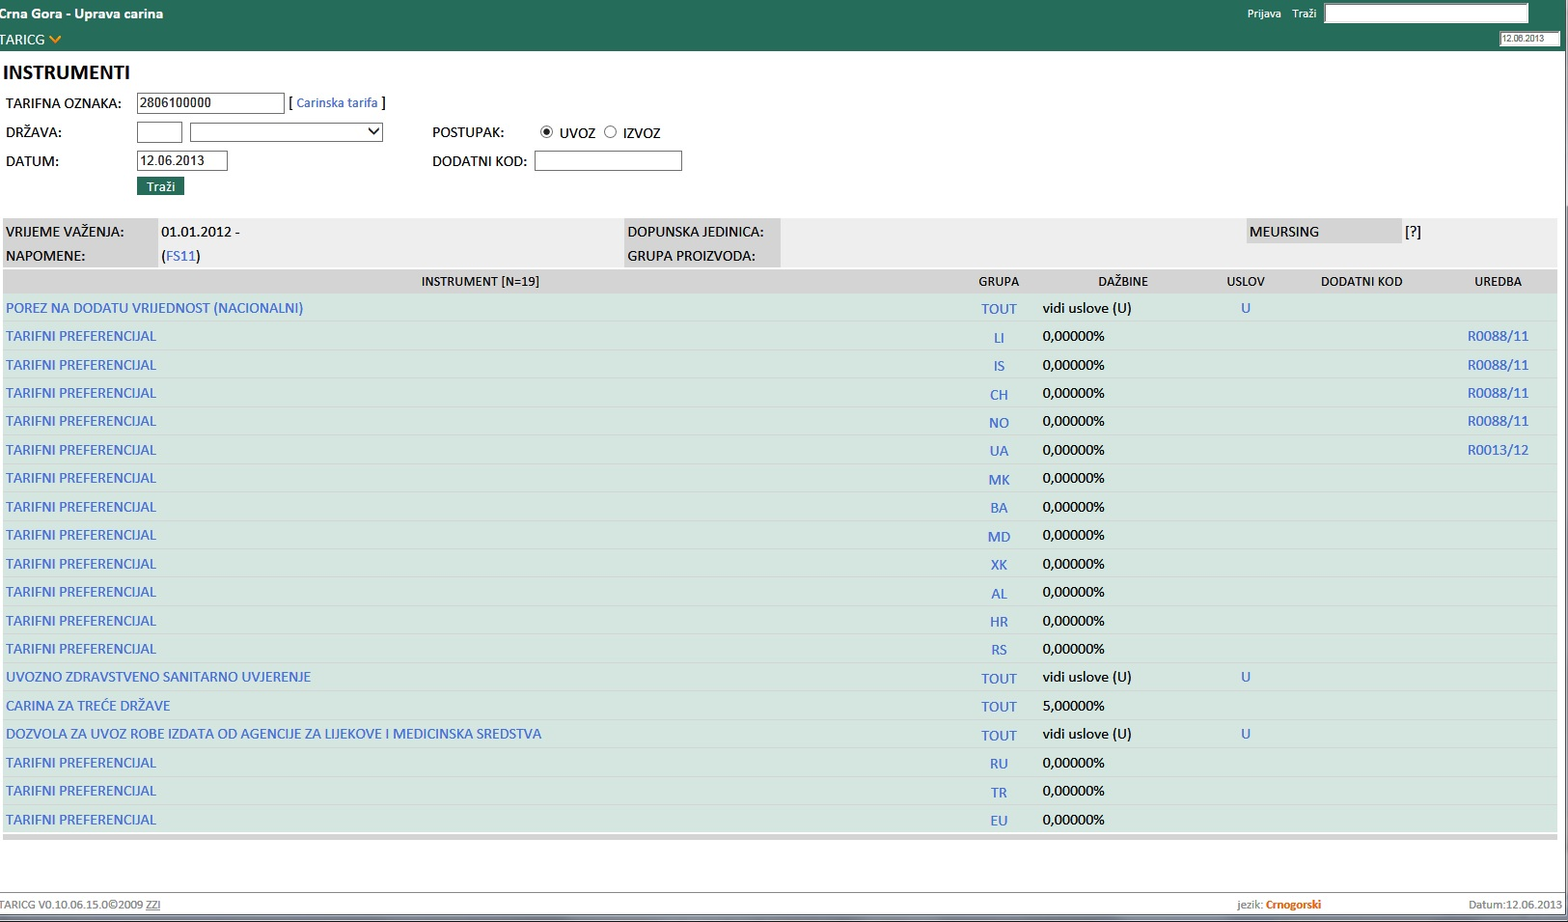
TARIC
CUSTOMS UNION
Chapter 29:
Chapter 29:
Customs union
M O N T E N E G R O
Negotiating Team for the Accession of Montenegro to the European Union
Chapter 29:
Customs union
M O N T E N E G R O
Negotiating Team for the Accession of Montenegro to the European Union

