Slide 1


M O N T E N E G R O
Negotiating Team for the Accession of Montenegro to the European Union
Working Group for Chapter 11 – Agriculture and Rural Development
MONTENEGRIN AGRICULTURE AND
AGRICULTURAL POLICY
Danijela Stolica
danijela.stolica@mpr. gov.me
Brussels, 11-13. December 2012

Slide 2

Presentation Outline
M O N T E N E G R O
Negotiating Team for the Accession of Montenegro to the European Union
Main features of Montenegrin agriculture
Agricultural policy: legal and strategic frame
EU accession: challenges, tasks and duties
2
Chapter 11
Agriculture and rural development

Slide 3

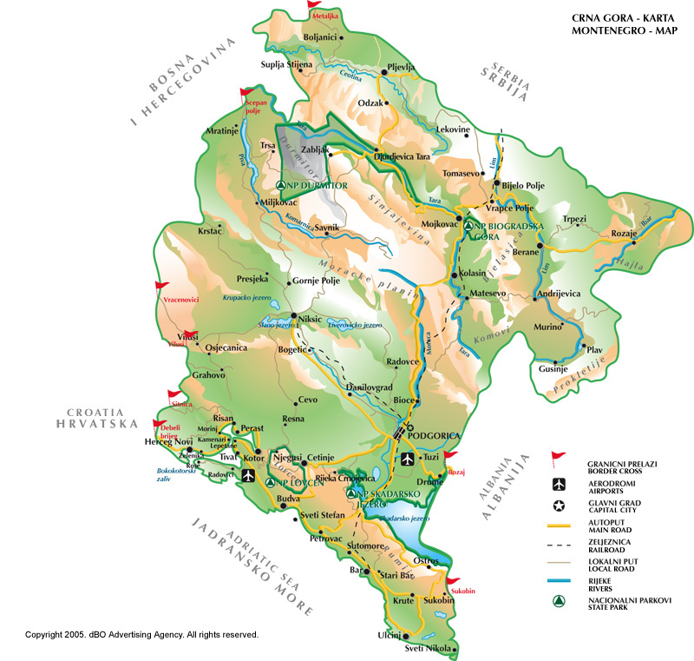

Montenegro:
Area – 13.812 km2,
Total population – 625.000
Popul. density – 45 inhab./km2
Capital – Podgorica
Divided into 21 municipalities
Coastline: 293.5 km
3

Slide 4
Main characteristics of Montenegro’s agriculture
M O N T E N E G R O
Negotiating Team for the Accession of Montenegro to the European Union
Land resources:
  516.000 ha of total agricultural land, or 0.82 ha per capita
  190.000 ha of arable land, or 0.30 ha per capita
Economic importance – high share in GDP, 8.3%,
Agriculture is labour intensive, plays a role of a social buffer – as the main source of income or a part of income for more than 47,000 of rural households
Structural characteristics: small family farms prevail, average size
≈ 5 ha, low productivity
Low level of use of chemicals (fertilizers and pesticides)
Chapter 11
Agriculture and rural development

Slide 5
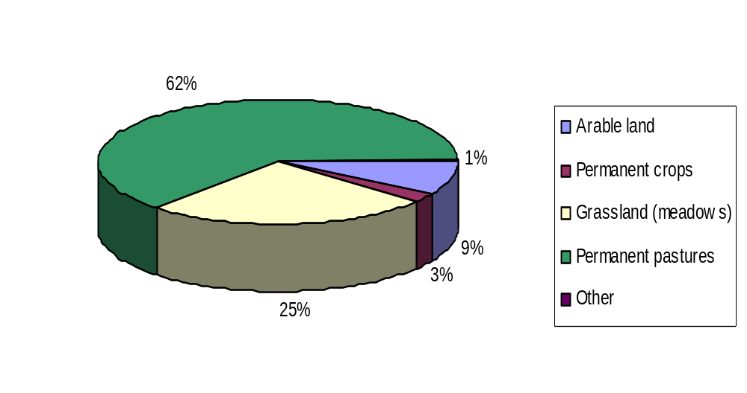
STRUCTURE OF AGRICULTURAL LAND
M O N T E N E G R O
Negotiating Team for the Accession of Montenegro to the European Union
Total Agricultural land - 516,070 ha
Arable land (fields and gardens) | 44,524 ha | Grassland (meadows) | 128,621 ha
Permanent crops | 16,107 ha | Permanent pastures | 325,436 ha
Other | 2,649 ha
Note: Results of Agricultural census in 2010 – Only 221,297.6 ha are used regularly by agricultural holdings !
Chapter 11
Agriculture and rural development

Slide 6
Agricultural and arable land by the regions
M O N T E N E G R O
Negotiating Team for the Accession of Montenegro to the European Union
Region | Total area |  | Agricultural land |  | Arable land
 | km² | % | ha | % | ha | %
Coastal | 1,591 | 11 | 51,019 | 9.9 | 18,766 | 9.9
Central | 4,917 | 36 | 153,525 | 30 | 44,497 | 24
Northern | 7,304 | 53 | 311,526 | 60 | 125,626 | 67
MNE total | 13,812 | 100 | 516,070 | 100 | 188,889 | 100
Data source: Source: MONSTAT- Statistical yearbook 2010
Chapter 11
Agriculture and rural development

Slide 7
M O N T E N E G R O
Negotiating Team for the Accession of Montenegro to the European Union
Total and used agricultural land
with ownership structure
Indicator | Total
Total available agricultural land
Number of holdings | 48,870
Total available land, ha | 309,240.7
Average holding size with agricultural land, ha | 6.3
Used agricultural land
Number of holdings | 48,277
Total agricultural land used, ha | 221,297.6
Average size of holdings using agricultural land, ha | 4.6
Ownership structure
Holder’s own land, ha | 176,251.3 (57%)
Land rented and collective land (katun, commune),ha | 132,989.4 (43%)
Source: MONSTAT – Agricultural Census 2010
Chapter 11
Agriculture and rural development

Slide 8
M O N T E N E G R O
Negotiating Team for the Accession of Montenegro to the European Union
Structure of used agricultural land
Category | Number of holdings |  | Used agricultural land
 | total | % | ha | %
< 0,50 ha | 18526 | 37,8 | 4130 | 1,9
0,50- < 1,00 ha | 8467 | 17,3 | 6347 | 2,9
1,00- < 5,00 ha | 16494 | 33,7 | 36025 | 16,3
5,00- < 10,00 ha | 2712 | 5,6 | 18532 | 8,4
10,00- < 20,00 ha | 1157 | 2,4 | 15490 | 7,0
20,00- < 50,00 ha | 642 | 1,3 | 20207 | 9,1
50,00- < 100,00 ha | 441 | 0,9 | 31646 | 14,3
> 100 ha | 431 | 0,9 | 88912 | 40,2
Total | 48870 | 100 | 221288 | 100
Source: MONSTAT
Chapter 11
Agriculture and rural development

Slide 9
Urban and rural population by the regions
M O N T E N E G R O
Negotiating Team for the Accession of Montenegro to the European Union
Region | Population, total | Urban population |  | Rural population
 |  | Figure | % | Figure | %
Coastal | 148,683 | 86,707 | 58.3 | 61,976 | 41.7
Central | 293,509 | 233,640 | 79.6 | 59,869 | 20.4
Northern | 177,837 | 71,673 | 40.3 | 106,164 | 59.7
Montenegro total | 620,029 | 392,020 | 63.2 | 228009 | 36.8
Data source: MONSTAT - Census 2011
Chapter 11
Agriculture and rural development

Slide 10
M O N T E N E G R O
Negotiating Team for the Accession of Montenegro to the European Union
Employment in Agriculture
Labour force at Family agricultural holdings by age groups
Category | Total employment |  | Annual Working Units
 | Number | % | Number | %
Up to 24 years | 6,717 | 6.8 | 2,304.9 | 5.0
Between 24 and 34 years | 11,340 | 11.5 | 4,838.6 | 10.4
Between 35 and 44 years | 15,675 | 15.9 | 7,606.8 | 16.4
Between 45 and 54 years | 21,562 | 21.9 | 10,447.9 | 22.5
Between 55 and 64 years | 19,849 | 20.2 | 10,001.6 | 21.5
65 years and over | 23,198 | 23.6 | 11,273.3 | 24.3
Montenegro, total | 98,341 | 100.0 | 46,473.0 | 100.0
Source: MONSTAT
Chapter 11
Agriculture and rural development

Slide 11
M O N T E N E G R O
Negotiating Team for the Accession of Montenegro to the European Union
Employment in Agriculture
Education of working persons in agriculture
No education 3.87%,
Unfinished primary education 5.79%,
Primary education 27.9%,
Any secondary school finished 53.33%,
Post-secondary or higher education 9.11%.
Source: MONSTAT
Chapter 11
Agriculture and rural development

Slide 12
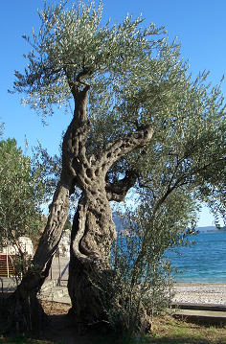
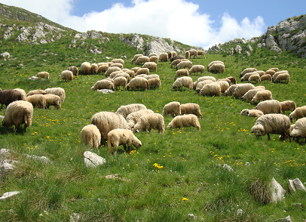
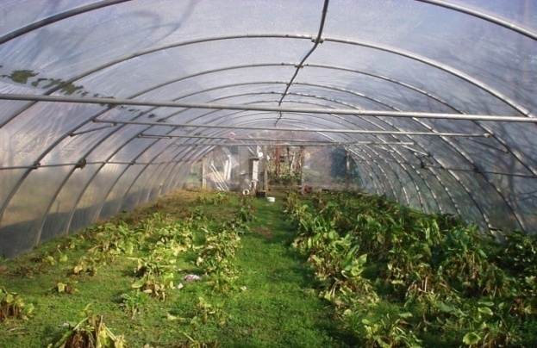
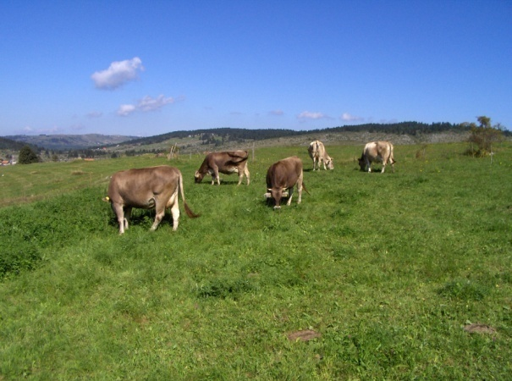
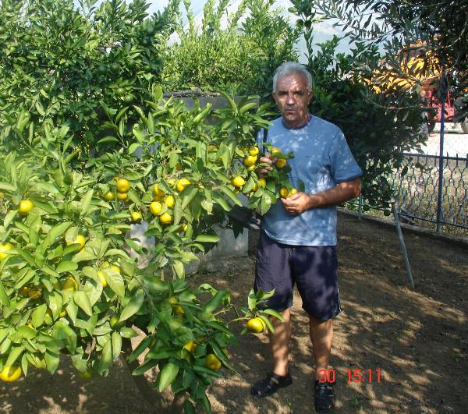
M O N T E N E G R O
Negotiating Team for the Accession of Montenegro to the European Union
MONTENEGRIN AGRICULTURE IS VERY DIVERSIFIED !
Olives & citruses
in the coastal part
Vegetables & vine
in the central part
Cattle & sheep,
in the northern part
Chapter 11
Agriculture and rural development

Slide 13
M O N T E N E G R O
Negotiating Team for the Accession of Montenegro to the European Union
Plant production
The plant production is dominated by: production of vegetables, grapes, potato, fruit, olives, while production of cereals is at a very low level.
A small volume of cereal production is one of specific features of Montenegro’s agriculture
According to the Statistical yearbook 2010, the plant production takes place on 12% of total agricultural area, of which field crop-vegetable production on 9%, and fruit-viticulture production on about 3% of total agricultural area. The total area in plant production has been reduced by about 4% in the period 2001-2010.
Chapter 11
Agriculture and rural development

Slide 14
M O N T E N E G R O
Negotiating Team for the Accession of Montenegro to the European Union
THE MAIN SUBESTORS IN AGRICULTURE
Fruit growing
Indicator | 2007 | 2008 | 2009 | 2010
Area* (ha) | 11,976 | 11,885 | 11,899 | 11,970
Total number of trees (000) | 2,740 | 2,746 | 2,799 | 2,753
Total fruit production (in 000 t) | 29.0 | 30.3 | 39.8 | 33.9
Sources: MONSTAT, Statistical yearbook 2011
In total number of trees plum, apple and pear prevail, while in the coastal part those are figs, oranges and tangerines.
In the northern part of Montenegro, plum prevails and is mainly used for brandy production (more than 95%), while a smaller part is processed into jams and preserves, dried or used fresh.
Chapter 11
Agriculture and rural development

Slide 15
M O N T E N E G R O
Negotiating Team for the Accession of Montenegro to the European Union
THE MAIN SUBSECTORS IN AGRICULTURE
Olive growing
Indicator | 2007 | 2008 | 2009 | 2010
Number of trees (000) | 417 | 418 | 406 | 408
Production (000 t) | 1.2 | 2.4 | 1.6 | 2.3
Yield per tree (kg) | 2.9 | 5.7 | 3.9 | 5.7
Sources: MONSTAT, Statistical yearbook 2011
About 70% of the plantations are traditional,
Variety structure - more than 90% are autochthons varieties (Žutica and others)
The potential allows production of more than 2,000 t of olive oil per year,
Chapter 11
Agriculture and rural development

Slide 16
M O N T E N E G R O
Negotiating Team for the Accession of Montenegro to the European Union
THE MAIN SUBESTORS IN AGRICULTURE
Vine growing and wine production
Indicator | 2007 | 2008 | 2009 | 2010
Area of vineyards (000 ha) | 4.2 | 4.3 | 4.4 | 4.4
No of vine plants (mil.) | 17.0 | 16.9 | 17.0 | 17.0
Production (000 t) | 35.4 | 44.0 | 39.0 | 40.0
Yield per ha (t) | 9.4 | 9.9 | 10.1 | 10.1
Yield per plant (kg) | 2.1 | 2.6 | 2.2 | 2.4
Sources: MONSTAT, Statistical yearbook 2011
Autochthonous grape vine varieties prevail (more than 70%) for red wine (Vranac, Kratošija) and white wines (Krstač),
Wine is by far the biggest export commodities (20 mil. euro) in food sector
Chapter 11
Agriculture and rural development

Slide 17
M O N T E N E G R O
Negotiating Team for the Accession of Montenegro to the European Union
THE MAIN SUBESTORS IN AGRICULTURE
Field crop and vegetable growing
The area of main field and vegetable crops (000 ha), 2007-2010
Indicator | 2007 | 2008 | 2009 | 2010
Plough land - total | 45.0 | 45.2 | 45. 7 | 45.4
Fallow | 13.6 | 13.9 | 13.8 | 14
Area sown | 31.3 | 31.3 | 31.9 | 31
Cereals | 5.2 | 5.1 | 5.2 | 5.0
Potato | 10.2 | 10.2 | 10.4 | 10.2
Vegetables (excl. potato) | 17.9 | 18.1 | 18.4 | 18.2
Tobacco | 0.16 | 0.15 | 0.13 | 0.12
Fodder | 8.0 | 7.9 | 8.1 | 7.6
Source: MONSTAT- Statistical yearbook 2011
Chapter 11
Agriculture and rural development

Slide 18
M O N T E N E G R O
Negotiating Team for the Accession of Montenegro to the European Union
THE MAIN SUBESTORS IN AGRICULTURE
The livestock sector
Main characteristics
The livestock plays a major part of the whole agriculture (more than 50% of total output),
Rearing of ruminants (cattle, sheep and goats) prevails due to the natural resources, while pig and poultry production are not well developed
No dual structure in rearing of ruminants – family farms prevail
There are some positive structural changes, size of farm/flock is increasing
Domestic production of meat and milk is far bellow the consumption (including tourism), self sufficiency for meat is about 36%, for milk is about 80%
Chapter 11
Agriculture and rural development

Slide 19
M O N T E N E G R O
Negotiating Team for the Accession of Montenegro to the European Union
THE MAIN SUBESTORS IN AGRICULTURE
The livestock sector
Cattle, sheep and goats population in Montenegro
Region | Cattle¹ |  | Sheep¹ |  | Goats²
 | Number | Share,% | Number | Share,% | Number | Share,%
Coastal | 6,374 | 7 | 10,553 | 5 | 5,417 | 15
Central | 23,372 | 24 | 50,019 | 25 | 18,734 | 54
Northern | 66,217 | 69 | 137,594 | 70 | 10,850 | 31
MNE total | 95,963 (67,259 -cows and heifers) | 100 | 198,165 | 100 | 35,001 | 100
Data Source: MONSTAT: ¹⁾ - Statistical yearbook 2011; ²⁾ - The Agricultural Census 2010
Chapter 11
Agriculture and rural development

Slide 20
M O N T E N E G R O
Negotiating Team for the Accession of Montenegro to the European Union
THE MAIN SUBESTORS IN AGRICULTURE
The livestock sector
Milk production in Montenegro
91% 6% 3%
Source: MONSTAT, Statistical Yearbook,2011, estimation for goats milk
Chapter 11
Agriculture and rural development

Slide 21
M O N T E N E G R O
Negotiating Team for the Accession of Montenegro to the European Union
THE MAIN SUBESTORS IN AGRICULTURE
The livestock sector
Meat production in Montenegro
Source: Meat Sector study, 2010
Chapter 11
Agriculture and rural development

Slide 22
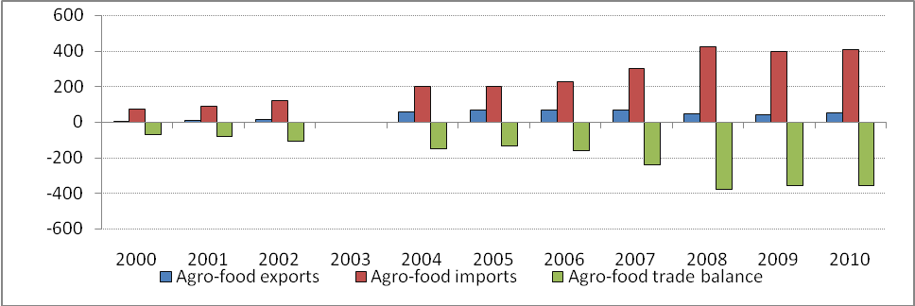
Foreign trade in agricultural-food products
M O N T E N E G R O
Negotiating Team for the Accession of Montenegro to the European Union
Chapter 11
Agriculture and rural development
22

Slide 23
SWOT analyses of the agriculture
M O N T E N E G R O
Negotiating Team for the Accession of Montenegro to the European Union
Strengths - Available land resources - Price competitiveness for limited number of products - Good preconditions for organic agriculture - Tradition in production - New capacities in the processing industry - Positive changes in the institutional frame | Weaknesses - Insufficient technological level causes low competitiveness - Small scale production – subsistence farming prevails - Age, social and educational level of producers are not favorable - The food chain is still weak
Opportunities Organic agriculture, Production of traditional certified products in greater volume, Tourism as a driving force for the local products, Export of wine, vegetables, fruit, lamb meat etc. | Threats Opening of the market can threaten the sensitive sectors Neglecting of agriculture in the general economical policy, lack of the support Failure in harmonization of the legislation with the EU Acquis and in capacity building
Chapter 11
Agriculture and rural development

Slide 24
Montenegro’s inequality compared to EU 27 and some of its Members
M O N T E N E G R O
Negotiating Team for the Accession of Montenegro to the European Union
Indicator | EU (27) | Austria | Slovenia | Bulgaria | MNE
Area, 000 km2 | 4,324,782 | 83,870 | 20,273 | 110,910 | 13,812
Population, 000 inhab. | 499,705 | 8,355 | 2,042 | 7,576 | 625
Population density, inhab/km2 | 115.5 | 101.1 | 100.7 | 68.4 | 45
GDP per capita, EUR | 23,500 | 32,900 | 17,300 | 4,600 | 4,744
GDP in agriculture, % | 1.1 | 0.9 | 1.1 | 3.8 | 8.3
Used agric. Land, 000 ha | 178,443 | 3,169 | 469 | 5,101 | 221
Average farm size, ha | 13.4 | 19.7 | 7.5 | 1.5 | 6.3
Area under forest, % | 42 | - | - | - | 44.3
Wheat yield, t/ha | 6.0 | 5.7 | 4.9 | 4.2 | 3.5
Potato production , t/ha | 29.2 | 33.2 | 22.8 | 16.3 | 13.1
Milk production, kg/cow | 6,346 | 6,060 | 5,067 | 3,419 | 2,500
Chapter 11
Agriculture and rural development

Slide 25
Institutional Support
M O N T E N E G R O
Negotiating Team for the Accession of Montenegro to the European Union
Ministry of Agriculture and Rural Development
  Veterinary Directorate
  Fitosanitary Directorate
Biotechnical Faculty
  The Livestock Selection Service
  The Extension Service in Plant Production
  Specialized Laboratories
Other state institutions and organizations
Advisory service at the local self governance level
Chapter 11
Agriculture and rural development

Slide 26
The main reforms in agriculture
M O N T E N E G R O
Negotiating Team for the Accession of Montenegro to the European Union
Preparation of the strategic documents
Preparation and adoption of laws
Capacity building and administration strengthening
International integrations: CEFTA
Membership in international organization (WTO, FAO; OIV etc.)
Accession to EU
Chapter 11
Agriculture and rural development

Slide 27
M O N T E N E G R O
Negotiating Team for the Accession of Montenegro to the European Union
Reforms in Agriculture – strategic documents
Strategy ‘’MONTENEGRO’S AGRICULTURE AND EUROPEAN UNION – Food Production and Rural Development
Main objectives:
sustainable resource management;
stable and acceptable supply of safe food;
ensuring an adequate standard of living for the rural population;
increase in competitiveness of food producers.
Chapter 11
Agriculture and rural development

Slide 28
National Programme for food production and rural development 2009-2013
M O N T E N E G R O
Negotiating Team for the Accession of Montenegro to the European Union
Operation program for implementation of Strategy
Framework for harmonisation of Montenegrian Agriculture with CAP,
Contains measures of agricultural policy (the three axis plus LEADER approach)
Multiannual financial plan for Agriculture (plan for each measure with financial sources)
Chapter 11
Agriculture and rural development

Slide 29
M O N T E N E G R O
Negotiating Team for the Accession of Montenegro to the European Union
National Programme – Measures 2009-2013
Group of measure | No Measures | Agro-budget% | Agrob. + others sources, %
1. Market policy | 9 | 29.0 | 26.7
2. Rural development policy | 17 | 39.3 | 42.2
3. Support to general services in agriculture | 8 | 18.0 | 18.3
4. Social transfers to rural population | 1 | 11.2 | 10.3
5. Tehnical and administrative support to Program implemenation | 1 | 2.5 | 2.5
Total | 36 | 100 | 100
Chapter 11
Agriculture and rural development

Slide 30
M O N T E N E G R O
Negotiating Team for the Accession of Montenegro to the European Union
Accession to EU
Objectives
Full integration into EU the legal system
The overcome structural and developmental weaknesses of the sector during pre-accession period
To build –up absorption capacites in agriculture enable to use possibilities of EU membership
Chapter 11
Agriculture and rural development

Slide 31
M O N T E N E G R O
Negotiating Team for the Accession of Montenegro to the European Union
Accession to EU
Objectives
To inrease competitiveness
To implement EU standards
To upgrade the whole food chain
To implement Rural Development policy as a tool for providing public goods and ensure good living standards for rural population
Chapter 11
Agriculture and rural development

Slide 32
M O N T E N E G R O
Negotiating Team for the Accession of Montenegro to the European Union
THE MAIN CHALLENGES AND TASKS
EU accession agenda – harmonization of the legislation with the EU Acquis communautaire, particularly at a level of sublaws and rulebooks and thier implementation
Full implementation of the national strategic documents
Implementation of IPARD program (coherent with the Strategy and NP)
To build-up an appropriate implementing stracture for agricultural policy harmonised with CAP (Paying agency, Managing authority, IACS…)
To strenghten analytical support to the agriculture and rural development
Raising of public awareness on the importance of agri sector in EU integrations
Chapter 11
Agriculture and rural development

Slide 33
M O N T E N E G R O
Negotiating Team for the Accession of Montenegro to the European Union
THE MAIN CHALLENGES AND TASKS
In Preparation of the New Strategy 2014-2020,
focus shall be on similar objectives like new CAP:
Viable food production
Sustainble managment of natural resources
Balanced territorial development
Chapter 11
Agriculture and rural development

Slide 34
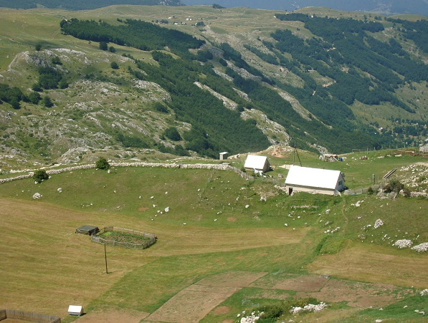
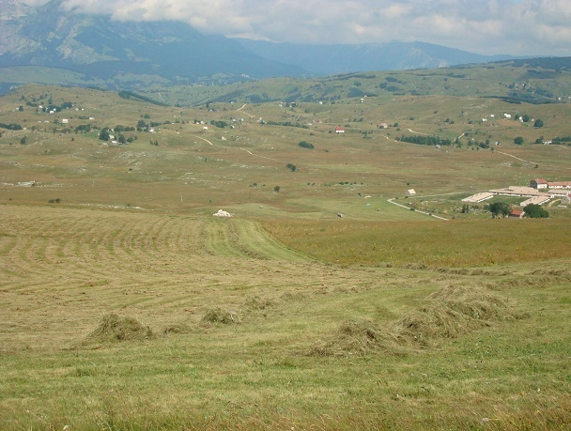
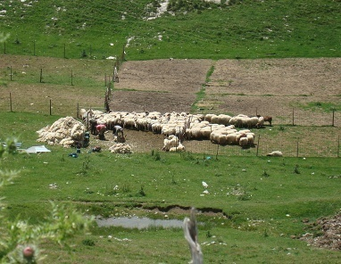
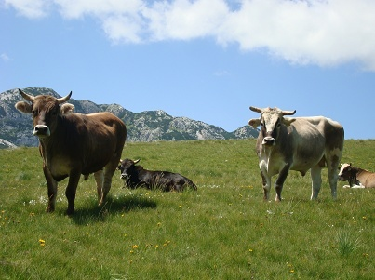
Mountain pasture with summer settlements called katuns

Slide 35
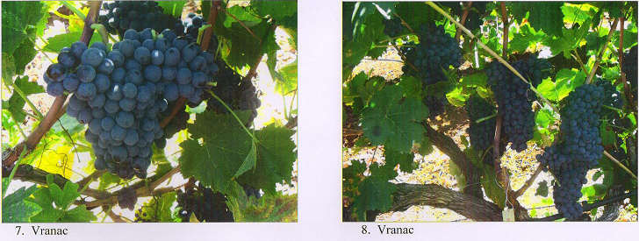
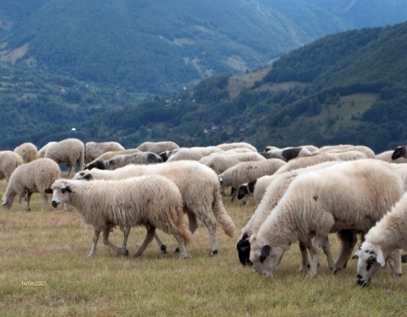
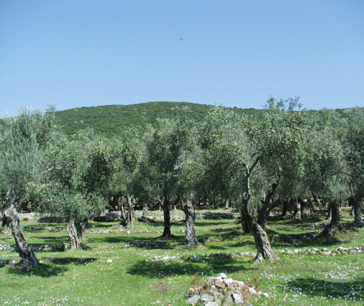

M O N T E N E G R O
Negotiating Team for the Accession of Montenegro to the European Union
Thank you for your attention !
Chapter 11
Agriculture and rural development

